Slide 1
The ABC of variant classification
is to ask the right questions
Gunnar D Houge MD PhD
Senior consultant/professor
Treasurer/ex-president, ESHG
Precision medicine lead, Western Norway
Haukeland University Hospital
Bergen, Norway

Slide 2
Disclaimer
This work has not received any commercial support
and the resulting ABC system for variant classification is free to use,
see www.eshg.org under News for the most updated version.
Suggestions for improvements are highly appreciated.

Slide 3

Background
In 2018, during my ESHG presidency, a task force was created to make a variant classification system
to guide variant reporting
and
to classify any variant or finding
this resulted in the
the ABC system
a system that can integrate any other system or IT/AI tool

Slide 4

Variant found...
What is the question?
ACMG/AMP classification
Is the variant pathogenic?
ABC classification
Is the variant clinically relevant?
Option of not reporting? ... Can we at a later time point risk being sued ?

Slide 5
Are we asking the right questions?
ACMG asks about pathogenicity – which is a difficult question because:
The penetrance is reduced: Many carriers of the variant remain healthy
The condition is recessive: Most carriers of the variant remain healthy
Clinical information and/or clinical knowledge could be lacking
ABC asks about clinical relevance – which a lab may struggle to answer because:
Clinical information and/or clinical knowledge could be lacking
But: Clinical relevance is an easier question to answer that pathogenicity

Slide 6
The ACMG/AMP system tries to answer the question of pathogenicity
P - Pathogenic
LP - Likely pathogenic (>90% / >95% for cancer)
VUS - Variant of uncertain significance
LB - Likely benign (>90% / >95% for cancer)
B - Benign
which is fine for dominant monogenic disorders of high penetrance,
but difficult for risk alleles and low-penetrant variants. System for these
are being elaborated, but will probably be different (i.e. more complexity)

Slide 7
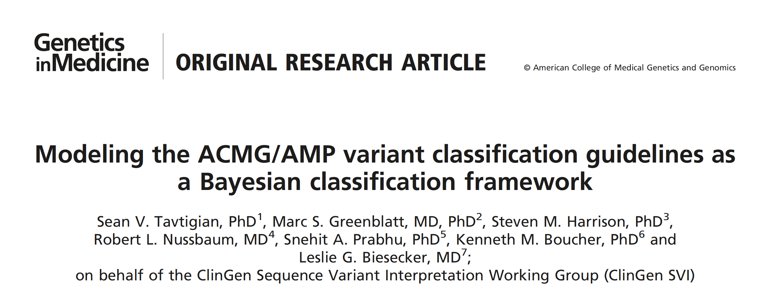
Using IT-based classification, variants of well-known clinical significance can be labelled a VUS
Beware that
The a priori likelihood that a variant is causative is defaulted to 10%
The odds-of-pathogenicity is the square root of the value above: 350 – 18.7 – 4.3 – 2.08
(= very strong / strong / moderate / supportive)

Slide 8
The ABC system answers 3 questions and can classify any type of finding
1. Does the variant affect gene function?
Unlikely Likely
2. Has the variant clinical relevance?
Risk factor Pathogenic
fVUS
0
HFE
3
Risk
2
Pat
3
LNF
2
LFE
4
Match
1
Pat
4
NF 1
5 FE
cVUS - 0
5 - Pat
ABC step A: Functional grading
ABC step B: Clinical grading
NF = Normal Function
LNF = Likely Normal Function
fVUS = functional VUS
HFE = Hypothetical Functional Effect
LFE = Likely Functional Effect / hypomorphic allele
FE = Functional Effect (e.g. LoF or GoF)
cVUS = clinical VUS («GUS») or no clinical information
Match = VOI: right type of gene for the phenotype
Risk = Known RISK FACTOR
Pat = PATHOGENIC variant,
penetrance-graded (3-5) when known

Slide 9

A grade 0-2 (no step B grading):
NORMAL findings
A+B grade 3 (class F):
NORMAL findings – no pathogenic or likely pathogenic variants were detected
A+B grade 4-5 (class E) and 6-7 (class D):
NORMAL findings – no pathogenic variants that could be related to the phenotype were detected
NORMAL findings – no pathogenic variants that could explain the phenotype were detected
VOI – A genetic variant of potential interest was detected
VOI – Heterozygosity for a recessive genetic variant of potential interest was detected
VOI – Hemizygosity for a genetic variant of potential interest was detected
VOI – Homozygosity for a genetic variant of potential interest was detected
RISK FACTOR – A genetic variant that increases susceptibility for this phenotype was detected
RISK FACTOR – Heterozygosity for a recessive genetic variant of interest was detected
PATH – Likely compound heterozygosity for recessive pathogenic variants was detected
PATH – Heterozygosity for a dominant likely pathogenic variant was detected
A+B grade 8 (class C), 9 (class B) and 10 (class A):
PATH – Homozygosity for a recessive pathogenic genetic variant was detected
PATH – Heterozygosity for a dominant pathogenic variant was detected
PATH – Heterozygosity for a dominant pathogenic variant of moderate penetrance was detected
PATH – Heterozygosity for a dominant pathogenic variant of high penetrance was detected
Incidental/unexpected findings and A+B grade 7-10 (class X):
IF – A genetic variant unrelated to the clinical question was detected
IF – No obvious match between genotype and phenotype. Further clinical investigations necessary
3. Should
the variant or
finding be
reported?
ABC step C:
Standard but
flexible variant
comments
based on joint
A+B class A to F
and adapted to
the clinical question

Slide 10
When is a variant a risk factor, a low penetrant variant, or pathogenic?
No consensus exists, but my suggestion is:
RISK FACTOR
PATHOGENIC VARIANT
Risk
factor
Low penetrant
variant
Moderate penetrance High penetrance
Lifetime
penetrance 0% 10% 25 % 50% 100%
F5-Leiden
(trombofilia)
CHEK2/ATM
(breast cancer)
KCNQ1
(LQTS1)
BRCA1/2
(breast/ovarian cancer)
E.g.

Slide 11
ABC points to remember
Steps A+B: Grades are clinical question independent – classifies a variant from F to A:
A known hypomorphic allele is by default step A grade 4 (= LFE)
A de novo unknown is never lower than step A grade 3 (= HFE)
A single recessive allele is not pathogenic in step B, maximum a RISK FACTOR
Step C: Standard comments are clinical question dependent:
This allows reporting of a hypomorphic or low penetrant variant when clinically relevant – otherwise not

Slide 12
ACMG criteria can be integrated into the ABC system, preliminary suggestion:
Step A
5 - FE PVS1 PS1 PS3 1 criterium enough to grade
4 - LFE PP1-Strong PM4 PM5 2 criteria or more: upgrade to FE
3 - HFE PS2 PS4 PM1 PM2 PP1 PP2 PP3 PP5 3 criteria or more: upgrade to LFE
0 – funct VUS not enough data to classify
2 - LNF BS1 BS2 BS3 BP1 BP2 BP3 BP4 BP5 BP6 BP7
1 - NF BA1
Note: One “pathogenic” ACMG criterium is enough to grade. Known hypomorphic alleles are by default grade 4 - LFE.
Step B
0 – clin VUS BS4, no clinical match or clinical Information
1 - VOI gene fits phenotype
2 - RISK FACTOR PM3 PP4 1 criterium is enough
3 - PATH known pathogenic (AR or AD)
4 - PATH known pathogenic (AD, moderate penetrance)
5 - PATH known pathogenic (AD, high penetrance)

Slide 13
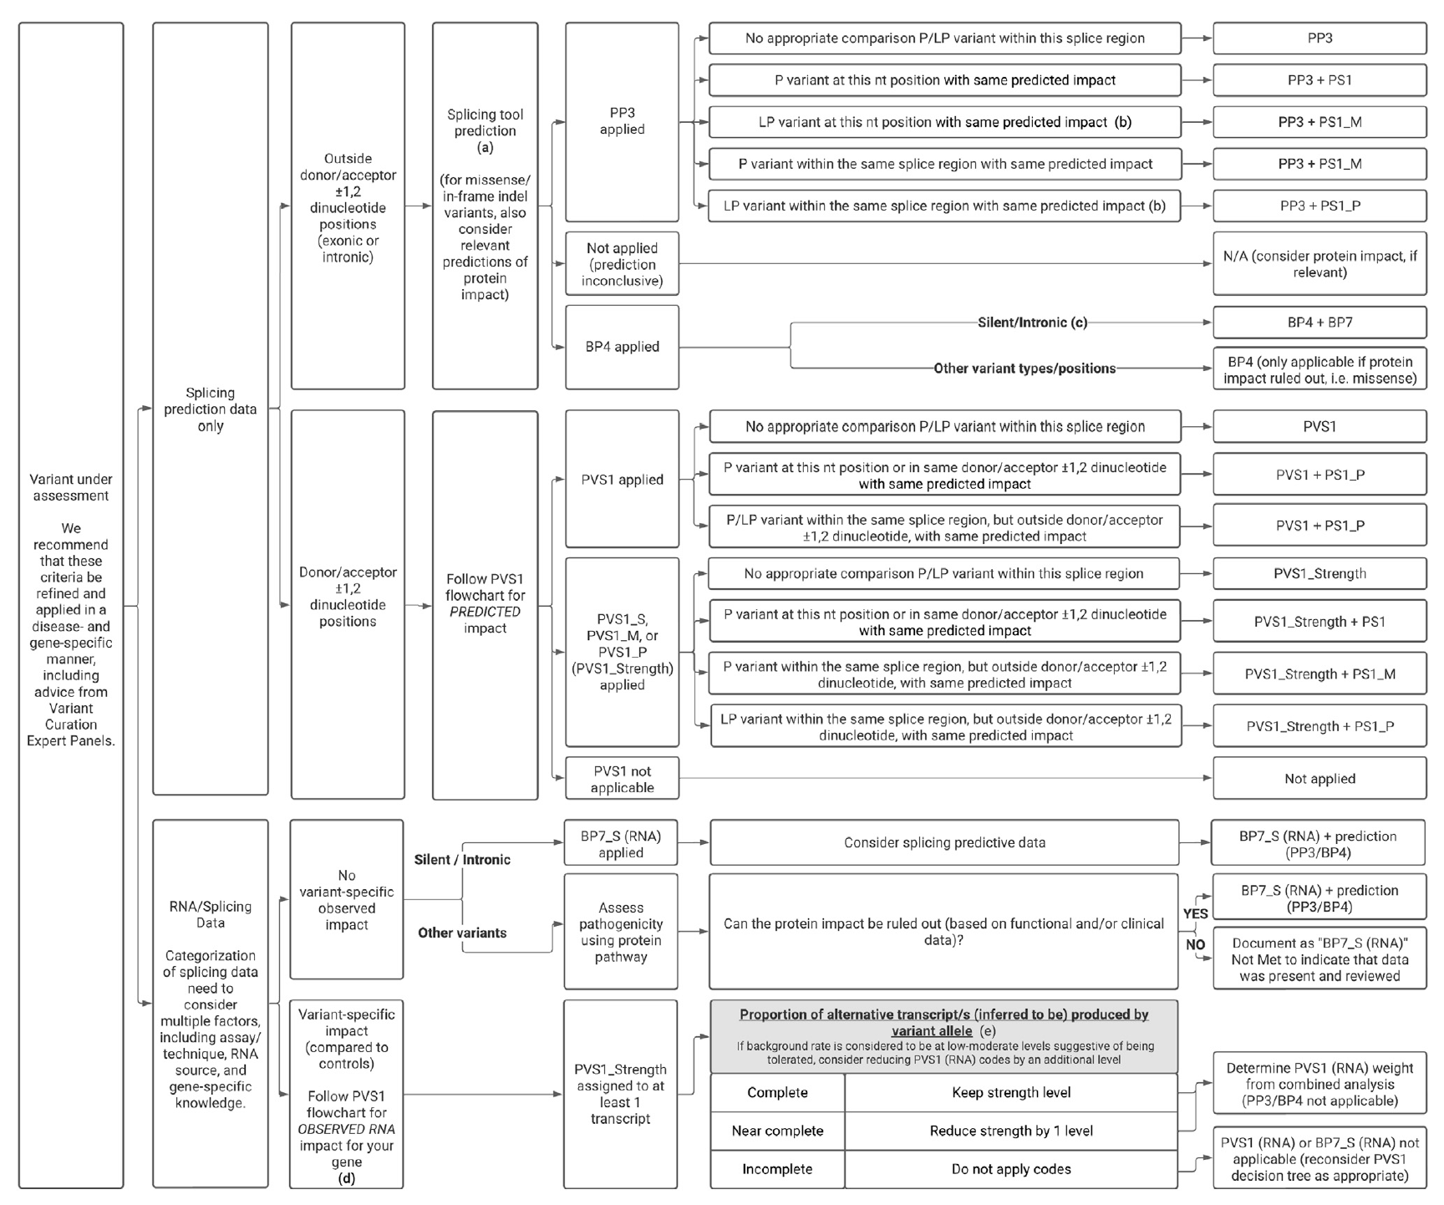
Splice variant evaluation
The variant classification
system (regardless which)
should integrate other
systems (like ACMG points,
REVEL, spliceAI and
AlphaMissense) - just
beware of double counting.
E.g. the suggested
ClinGen SVI subgroup’s
flow-chart for splice variant
evaluation

Slide 14
A
Functional effect Yes 5
Likely 4
Hypothetically 3
Not likely (LNF) 2
No (NF) 1
Unknown 0
Use all available computer tools to help,
including AI tools and point-based ACMG grading.
By default: Hypomorhic alles are 4, de novo min. 3

Slide 15
B
Clinical match No – or unknown 0
Hypothetical 1 – VOI
Known 2 – RISK FACTOR
Pathogenic (AD) 3 – PATH
4 – PATH mod.
5 – PATH high
Indication and some clinical information needed.
Use Exomizer and similar HPO tools to help.

Slide 16
C
Pick a standard comment
NORMAL (4 alternatives)
VOI – Variant-of-Interest (4 alternatives)
RISK FACTOR – known (2 alternatives)
PATH – pathogenic (6 alternatives)
IF – incidental finding (2 alternatives)

Slide 17
Why is the clinical question so important?
It could determine if a variant or finding should be reported
It could help the lab to look in the right place
It is crucial for successful use of AI tools to classify variants!
Question
AI
The quality of the question is just as
important as the quality of the input*
Data sources
*Geir KF Sandve, professor in informatics and AI researcher

Slide 18
An ESHG study of
ACMG and ABC classification comparison
of ten challenging cases

Slide 19
83 / 91
64 / 67
67 / 86

Slide 20
Case 8: no clinical match, but known Noonan-associated PTPN11 variant
Finding NM_002834.5(PTPN11): c.802G>A, p.(Gly268Ser)
Not in gnomAD 4.0, ClinVar 9x P/LP, Literature: Reported several times
as a cause of Noonan syndrome. No functional tests, never reported as de novo.
Clinic Incidental finding in young man with rhabdomyolysis (and high CK) after
strong physical exercise.
ACMG PS1 (established pathogenic) + PM2 (not in gnomAD) results in class LP. Report?
ABC Step A (functional) grade 3 (HFE - hypotetical functional effect)
Step B (clinical) grade 1 (VOI – variant of interest), leads to A+B = 4 and
Step C class E - and a standard comment in line with local/national/international
guidelines can be picked (personally, I would not have reported it)
ESHG study: 2/3 or labs would report - regardless of classification system used

Slide 21
Case 1: Well-known CHEK2 variant
CHEK2(NM_001005735.2) c.599T>C, p.(Ile200Thr) Monoallelic variant
gnomAD MAF 0.49%, pLI = 0
ClinVar: ~20x LP/P, 10x VUS
Functional assay (good lab): LoF allele
Literature: Many articles mentioning the variant as cancer associated
Clinical information: Female with breast cancer age 41, maternal aunt breast cancer age 38, paternal sister breast cancer age 36. No other finding upon extensive testing.
Survey result among 41 laboratories:
ACMG classified from VUS to P, mostly VUS (average 3.5).
ABC classified as HFE to FE in step A, average LFE (4.3) and in step B as RISK FACTOR,
gives joint grade 3+2=5 or class E - that one may choose to report or not.

Slide 22
Case 10: Well-known hypomorphic ABCA4 allele
ABCA4(NM_000350.3) c.5603A>T, p.(Asn1868Ile) Monoallelic variant
ABCA4 is the only known causal gene of Stargardt-type macular dystrophy
gnomAD MAF 4.2% (364 homozygous), pLI = 0
ClinVar: 9 times B/LB, 4 times VUS, 3 times LP
Functional testing: No data
Literature: Definite Stargardt-disease associated hypomorphic allele (PMID 28446513)
Clinical information given: Man 40 years with poor vision and strong clinical suspicion of Stargardt-type macular dystrophy
Survey result among 41 laboratories:
ACMG classified from B to VUS, mostly VUS (average 2.7)
ABC classified from VUS to LFE, mostly LFE (average 3.6), and in step B as RISK FACTOR

Slide 23
Case 10: Example of
wide-spread and
non-concordant
ACMG criteria selection
Lab# | PS1 | PS3 | PS4 | PM1 | PM3 | PM5 | PP2 | PP3 | PP4 | PP5 | BA1 | BS1 | BS2 | BP4 | BP6 |  | #
1 |  |  |  |  | 1 |  |  |  | 1 | 1 |  | 1 |  |  |  |  | 4
2 |  |  |  |  |  |  |  |  |  |  |  |  |  |  |  |  | 0
3 |  | 1 |  |  |  |  | 1 |  |  | 1 | 1 |  |  | 1 |  |  | 5
4 |  |  |  |  |  |  |  |  |  |  |  |  |  |  |  |  | 0
5 |  |  |  |  |  |  | 1 | 1 |  |  |  | 1 |  | 1 | 1 |  | 5
6 |  |  |  |  |  |  |  |  |  |  | 1 |  |  |  |  |  | 1
7 |  |  |  | 1 |  |  |  | 1 |  |  | 1 |  |  |  |  |  | 3
8 |  |  |  |  |  |  |  |  |  |  |  | 1 |  |  |  |  | 1
9 |  |  |  |  |  |  |  |  |  |  |  |  |  |  |  |  | 0
10 |  |  |  |  |  |  |  | 1 |  |  |  | 1 | 1 |  |  |  | 3
11 |  | 1 |  |  |  |  | 1 |  |  | 1 | 1 |  | 1 |  |  |  | 5
12 |  |  |  | 1 |  |  |  | 1 | 1 |  |  | 1 |  |  |  |  | 4
13 |  |  |  |  |  |  |  |  |  |  | 1 |  |  |  |  |  | 1
14 |  |  |  |  |  |  |  | 1 |  | 1 |  | 1 |  |  |  |  | 3
15 |  |  |  |  |  |  |  | 1 | 1 | 1 |  |  |  |  |  |  | 3
16 |  |  |  |  |  |  |  |  |  | 1 |  | 1 | 1 | 1 |  |  | 4
17 |  | 1 |  |  |  |  | 1 |  |  | 1 | 1 |  |  |  |  |  | 4
18 |  |  |  |  |  |  |  |  | 1 |  |  | 1 | 1 |  |  |  | 3
19 |  |  | 1 |  |  |  |  | 1 | 1 |  |  |  |  |  |  |  | 3
20 |  |  |  |  |  |  |  |  | 1 |  | 1 |  |  |  |  |  | 2
21 |  |  |  |  |  |  |  |  |  |  |  |  |  |  |  |  | 0
22 |  |  |  |  |  |  |  | 1 |  |  | 1 |  |  |  |  |  | 2
23 |  |  |  |  |  |  |  |  |  |  |  | 1 |  | 1 |  |  | 2
24 |  |  |  | 1 |  |  |  | 1 |  |  |  | 1 |  |  |  |  | 3
25 |  |  |  | 1 |  |  |  | 1 |  |  |  |  |  |  |  |  | 2
26 |  |  |  |  |  |  |  |  | 1 | 1 |  | 1 |  |  |  |  | 3
27 |  | 1 |  |  |  |  | 1 |  |  | 1 | 1 |  |  | 1 |  |  | 5
28 |  |  |  |  |  | 1 | 1 |  |  |  |  |  | 1 |  |  |  | 3
29 |  |  |  |  |  |  |  | 1 | 1 |  |  | 1 |  |  |  |  | 3
30 |  |  |  |  |  |  |  | 1 | 1 |  |  | 1 |  |  |  |  | 3
31 |  |  |  |  |  |  |  |  |  |  |  |  |  |  |  |  | 0
32 |  |  |  |  |  |  |  | 1 | 1 |  |  | 1 |  |  |  |  | 3
33 |  |  |  |  |  |  |  |  |  |  |  |  |  |  |  |  | 0
34 |  | 1 |  |  | 1 |  |  |  |  |  |  |  |  |  |  |  | 2
35 |  |  |  |  |  |  |  |  |  |  |  |  |  |  |  |  | 0
36 |  |  |  |  |  |  |  |  |  |  |  |  |  |  |  |  | 0
37 |  |  | 1 |  | 1 |  |  |  |  |  |  | 1 |  |  |  |  | 3
38 |  | 1 |  |  |  |  | 1 |  |  | 1 | 1 |  |  | 1 |  |  | 5
39 |  |  |  |  |  |  |  |  |  |  |  |  |  |  |  |  | 0
40 | 1 |  |  |  | 1 |  | 1 |  |  |  | 1 |  |  | 1 |  |  | 5
41 |  |  |  |  |  |  |  |  |  |  |  |  |  |  |  |  | 0
42 |  |  |  |  |  |  |  |  | 1 |  |  |  |  |  |  |  | 1
43 |  | 1 |  | 1 |  |  |  |  |  | 1 | 1 |  |  | 1 |  |  | 5
SUM | 1 | 7 | 2 | 5 | 4 | 1 | 8 | 13 | 11 | 11 | 12 | 15 | 5 | 8 | 1 |  | 2,419 | n=33
 |  | 0,21 |  | 0,15 | 0,12 |  | 0,24 | 0,39 | 0,33 | 0,33 | 0,36 | 0,45 | 0,15 | 0,24 |  |  | 0,27 | (0,12-0,39)
 | 0,03 | 0,21 | 0,06 | 0,15 | 0,12 | 0,03 | 0,24 | 0,39 | 0,33 | 0,33 | 0,36 | 0,45 | 0,15 | 0,24 | 0,03 |  | 0,21
Carrier of
ABCA4 Asn1868Ile
and no second
variant in a 40 years
old male patient
with classical
Stargardt disease
On average
27% corcordance
No single criteria
used by >50%
of the
laboratories

Slide 24
Average 46%

Slide 25
Case 10:
Should it
be reported?
95%
83%
67%
-12%
-28%

Slide 26
Carrier of the F5 Leiden «mutation»
F5(NM_000130.4) c.1691G>A, Arg506Gln Monoallelic variant
gnomAD MAF 5% (Europeans), i.e. ˜10% are carriers
Functional assay: GoF variant due to resistance to activated protein C (APC)
Literature: DVT associated, heterozygosity increases thrombosis risk ˜3 times.
ACMG: PS3 (function) PS4 (prevalence) PP1 (co-segregation) BA1 (gnomAD) = a VUS
ABC: A-5 (FE) + B-2 (risk factor) = class D (6-7),
Report step C: RISK FACTOR and report if relevant clinic / normal if incidental finding

Slide 27
.arr[GRCh37] 9q21.31(82125508_83332721)x1
Clinic: Girl 11y with feeding difficulties and learning problems. Mother and father also have learning problems, not tested (yet).
Finding: 1,2 Mb deletion removing one gene, TLE4, encoding a trancriptional repressor. Nothing in databases (gnomAD, DGV etc),
low statistical LoF tolerance: gnomAD pLI = 1, o/e = 0.09.
ACMG:
CNV: 1A (contains a gene) 2H (HI gene) 5F (unknown inh.) = 0.15
SNP: PVS1 (deletion) PM2 (gnomAD) = LP, but the GUS makes it a VUS.
ABC: A-5 (FE) + B-1 (right type of gene) = C class D and a VOI comment.

Slide 28
Extensive IBD in first child of first cousins
Clinic: Girl 2y with severe NDD with hypotonia, bad epilepsy, dysmorphic face, normal HC and brain-MRI.
Finding: SNP array: 180 Mb of ROH (runs of homozygosity) >5Mb / 10 chromosomes.
ACMG: Cannot be classified
ABC: A-3 (HFE) + B-2 (risk factor) = C class E and a RISK FACTOR comment,
further clinical evaluation/laboratory testing (NGS) could be indicated.

Slide 29
EpiSign methylation signature
Clinic: Boy 8 mo with feeding difficulties (needed PEG), NDD with hypotonia, and short stature.
Finding: High-resolution copy number array and TRIO-WES normal. EpiSign methylation profile suggested Wiedemann-Steiner (WSS) syndrome.
ACMG: Cannot be classified.
ABC: A-3 (HFE) + B-1 (match) = C class E and pick of a VOI comment.

Slide 30
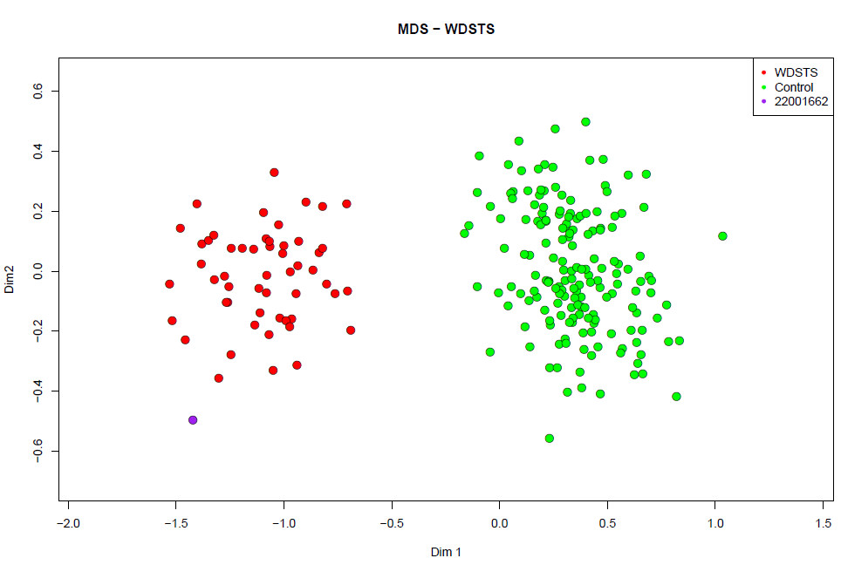
After the EpiSign result,
inspection of the NGS BAM file
revealed a de novo
NM_001197104.1(KMT2A)
c.3648dupA p. (Glu1217Argfs*5)
confirming the WSS diagnosis
Campbell Christopher
Banka Siddharth
Manchester University NHS FT

Slide 31
The ABC classification system of variants/findings
A logical, two-step A+B grading
Any type of (epi)genetic finding can be classified
Hypomorphic and low penetrant alleles are not labelled as «VUS»
Can incorporate ACMG points and gene-specific criteria (like VCEP recommendations)
Can incorporate all desired computer/AI-based systems, but avoid double counting
In step C a standard comment adapted to the clinical question is picked
Findings that are not pathogenic are not labelled pathogenic
Classification can be done by one (CLG), two (CLG+MD/GC) or many (MDT) persons

Slide 32
Take home message # 1
Clinical information is essential for variant classification because
1) it provides the question – that could guide variant reporting
2) it increases variant pick-up rate
SolveRD: Pick-up rate increased from 50% to 70% by 2-level expert review:
First molecular, then clinical (data analysis + data interpretation task forces)

Slide 33
Take home message # 2
The use of the word pathogenic should correlate with
the actual risk of developing disease.

Slide 34
Variant classification and reporting in the future
A
CLG does
Functional grading
As computerized as possible:
ACMG scoring (points)
AI-based tools
Other prediction tools
Grade 0 to 5
(the 0’s will mostly be
outside the exome)
B
CLG/GC/MD/MDT does
Clinical grading
Clinical fit?
Right type of gene?
Tools linking genotype to phenotype
(Exomiser etc)
Grade 0 to 3 (sometimes 4-5)
NO match (or unknown)
VOI - Variant-of-Interest
RISK FACTOR
PATH – Pathogenic
C
CLG/GC/MD/MDT selects
A standard comment
Dependent on clinical question
Not the same as a clinical report

Slide 35
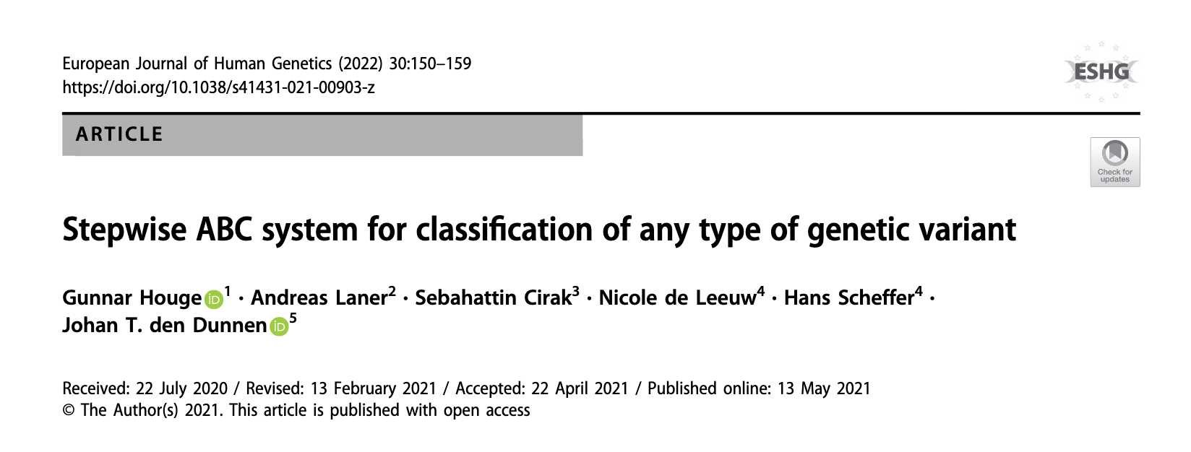
ACKNOWLEDGEMENTS
Now in EJHG: Comparison of the ABC and ACMG systems for variant classification
- a truly collaborative effort of 49 authors from 43 laboratories (Open Access)
See www.eshg.org under News for an updated version, including presentations

